Slide 1


Mentoring program training session
<date, time, host>

Slide 2

Acknowledgement of Country
I would like to begin by acknowledging the <insert name of people here (e.g. Ngunnawal)> people, Traditional Custodians of the land on which we <gather/meet> today, and pay my respects to their Elders past and present. I extend that respect to Aboriginal and Torres Strait Islander peoples here today.
Notes:
Only Traditional Owners/Custodians of the land on which the event takes place can deliver a Welcome to Country. If a Traditional Owner is not available to do a Welcome to Country, an Acknowledgement of Country can be delivered instead. There are 3 types of Acknowledgement of Country: generic, specific and general.
This slide provides a specific Acknowledgement of Country that can be used where there are no disputes and you know the name of the people on whose land you are gathered. LDATs need to insert the name of the Traditional Owners/Custodians of the land on which they gather/meet for the mentoring program orientation session.
LDATs may wish to adapt this slide to deliver a Welcome to Country, or an Acknowledgement of Country using the wording of their own organisation.
For more information visit: www.indigenous.gov.au/contact-us/welcome_acknowledgement-country

Slide 3

Session overview
Introductions and welcome
AOD harm prevention
Alcohol and young people
Roles and responsibilities
Policies and procedures
Communication and relationships
Working with different groups and cultures
Notes:
Introductions and welcome
Welcome participants and introduce the training session hosts and participants. LDATs may wish to use the Ice-breaker Activity: Introductions – see “training games and activities” in guide- this is an optional exercise.
Present the session overview, objectives and outcomes.
Objective/outcome: To support mentors to develop the knowledge, skills and attitudes needed to effectively mentor a young person.

Slide 4
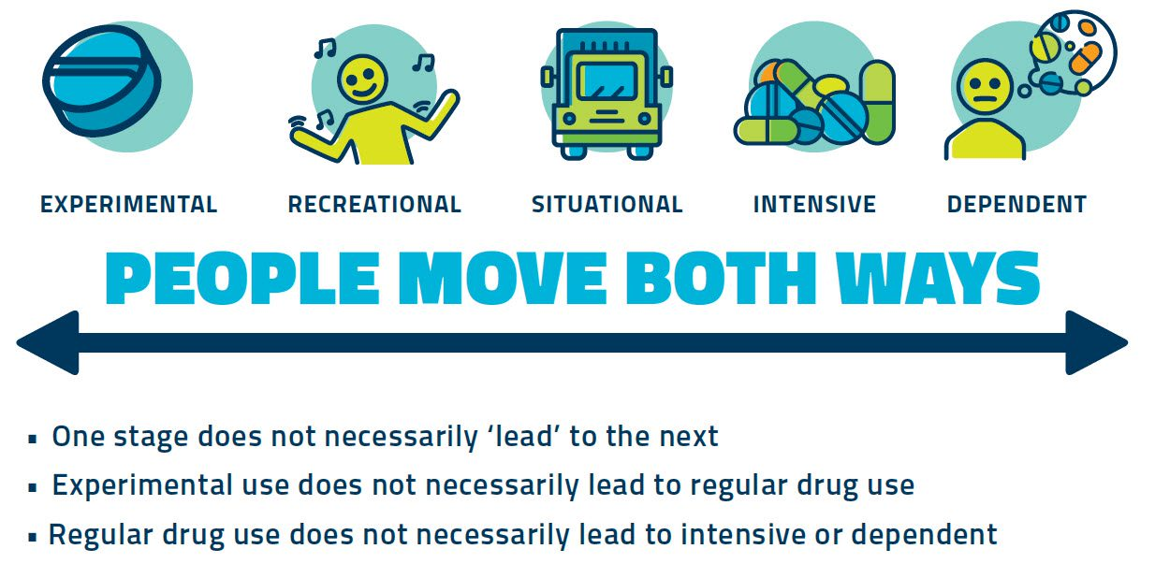

Alcohol and drug use
Notes:
Stages of drug use diagram
This slide demonstrates that people may use drugs for different reasons and that there is a spectrum of drug use. One stage does not necessarily lead to the next, and people may move both ways through the spectrum.
Experimental: curiosity (try once or twice), low tolerance so high effects
Recreational: enjoyment - socially/change mood for specific occasions
Situational: cope with situations e.g. amphetamines by long distance truck drivers
Intensive: binging (being wasted), consume heavy amount of drugs over a short period.
Dependent: after prolonged regular or heavy use, take drug to feel normal or stop uncomfortable withdrawal symptoms. Using a depressant drug to help with the ‘come down’ effects of stimulants may result in a cycle of dependence on both types of drugs or overdoes.
Important to see the person, not the drug. Zero tolerance only serves to punish and stigmatize people affected by drug use/issues. Harm minimisation and preventive approaches focus on the health and wellbeing of people affected by illegal drug use which serve to counter risk factors.
LDATs can generate discussion to reflect on parents own use of alcohol or caffeine:
- can they identify different stages of their own use?
How do they feel about these different stages?
Is the way people move through these stages different to what they thought?

Slide 5
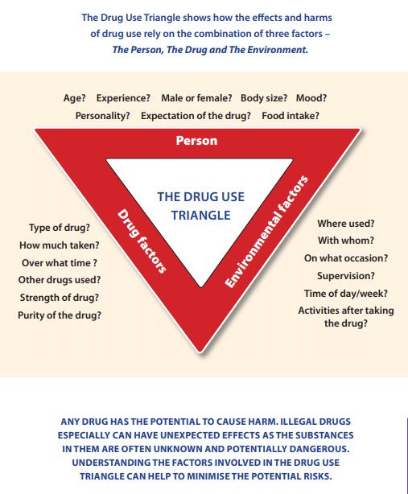
Alcohol and drug use
Notes:
The Drug Use triangle
The drug use triangle shows how the effects and harms of drug use relay on the combination of three factors – The Person, The Drug and The Environment.
Any drug has the potential to cause harm. Illegal drugs especially can have unexpected effects as the substances in them are often unknown and potentially dangerous. Understanding the factors involved in the drug use triangle can help to minimise the potential risks.
Talk through some of the prompts on each side of the triangle.
The LDAT can then generate discussion about the interrelationship of the three factors by using an example such as drinking alcohol at the end of a stressful hard week, as opposed to at a lunch with friends.

Slide 6

AOD primary prevention
Primary prevention: actions aimed at preventing illness or enhancing the wellbeing of the general population
Risk factors: increase the likelihood of frequent or excessive drug use
Protective factors: reduce the likelihood of frequent or excessive drug use
Resilience: is the capacity to still find determination and reason to cope with a situation despite all odds, and to see it as an opportunity for growth.
Notes:
AOD harm prevention
AOD and Primary Prevention, including risk and protective factors – available as a downloadable resource for you to provide to your mentors.
Explain that many factors can influence a young person’s health, wellbeing and development. Some factors can have a positive effect in reducing alcohol and other drug use (protective factors), and other factors (risk factors) may increase the likelihood of a young person experimenting with alcohol and drugs. By identifying both the risk and protective factors, families and communities can work together to reduce AOD harm and delay uptake amongst young people.

Slide 7
AOD primary prevention
Risk and protective factors look different depending on the “domain” e.g. individual, family, leisure, school, local community or broader environment
What works also looks different in each of these domains.
Notes:
What parents need to know: AOD harm prevention continued…
LDATs can generate discussion to explore risk and protective factors by asking participants:
Does this understanding of the different factors that can increase or reduce the risk of AOD harms help to highlight opportunities for taking action to prevention AOD harms from occurring in the first place? (rather than treating problems after they occur)
How do mentoring programs help to prevent and minimise alcohol and other drug harms?
Additional points to share:
Many factors can influence a young person’s health, wellbeing and development. Peer, family, social activities and school can all influence alcohol and other drug use behaviours among young people.
Some factors can have a positive effect in reducing alcohol and other drug use, such as strong relationships between parents and their children. These protective factors help to prevent or ‘protect’ against AOD use and harms. Other factors, known as risk factors, may increase the likelihood of a young person experimenting with alcohol and drugs. Risk factors include family conflict and the availability of alcohol in the community.
By identifying both the risk and protective factors, families and communities can work together to reduce AOD harm and delay uptake amongst young people.
Mentoring programs can help to prevent and minimise alcohol and other drug harms. The presence of non-related adults in a young person’s life can have a positive influence, particularly when those adults provide strong emotional support over a period of time. The protective influence of caring, competent adults who are not parents is significant, particularly in the lives of young people facing challenges.

Slide 8
Reducing stigma
People should not be defined by their alcohol and other drug use​
Language is broader than just the words used
Alcohol and other drug use is a health and social issue​
Look for the most recent consensus on appropriate language as terms can become outdated as language evolves​
Choose terms that are strengths based and empowering and convey messages of protective and preventative measures
Notes:
AOD harm prevention
Avoiding stigmatising language checklist (summarised on slides) – this is available as a downloadable resource for you to share with your participants​.
What is stigma?​
Stigma is where a person or group of people are perceived as less acceptable due to a specific trait or behaviour. Stigma has the potential to leave the person or people subjected to it feeling alienated and marginalised. ​
Explain that we can all dramatically reduce the impact of stigma by reconsidering how we think about people who use alcohol or other drugs (AOD) and choosing words that focus on people, rather than their AOD use. The right words can reduce stigma, which is a very real and complex problem, and have the power to improve health outcomes.​

Slide 9

Reducing stigma
Convey factual and accurate information and terminology
Include help seeking information to encourage connections with health or harm reduction services.
Words can mean different things to different audiences, depending on language and cultural contexts
People who use/have used drugs will refer to themselves and their life experiences in different ways – that is their choice
Ask the individual what terminology they prefer.
Notes:
AOD harm prevention
Avoiding stigmatising language checklist continued…
Provide fact sheet + discussion activity
LDATs can generate discussion to explore the power of words by asking participants:
What words may have negative connotations, and make people who use or have used alcohol and other drugs feel unwelcome and unsafe and stop them from seeking the services they need?
When engaging with, or around people, who use alcohol and other drugs, what words could we use that are welcoming, inclusive and empowering?
Additional resources:
The Power of Words resource: https://adf.org.au/resources/power-words/

Slide 10
Alcohol use and harms
Alcohol is the most consumed drug in Australia, and it’s the drug most commonly used by young people
Alcohol contributes to all the leading causes of death for young people: suicide, land transport accidents, accidental poisoning, and assault
Long-term alcohol consumption is linked to six different types of cancer, cardiovascular disease, and liver disease.
Notes:
Young people
Explain that alcohol is a common drug in Australia and among young people. Alcohol use results in serious short and long-term harms.
LDATs can generate discussion to explore the importance of focusing on alcohol and reducing AOD harm by asking participants:
Reflect on your own childhood and experiences with alcohol – have attitudes to alcohol changed over time?
Additional points to share:
Alcohol is the most consumed drug in Australia, and it’s the drug most commonly used by young people.
Alcohol contributes to all the leading causes of death for young people: suicide, land transport accidents, accidental poisoning, and assault.
In a 2016-17 survey of young Australians aged 14–19 years who were drinking at risky levels, 83% reported being injured as a result of that drinking in the past year.
Early drinking, even sips or tastes, is connected to earlier and more harmful patterns of alcohol consumption.
Long-term alcohol consumption is linked to six different types of cancer, cardiovascular disease, and liver disease.
Although some young people are still drinking, and drinking in risky ways, fewer young people overall are choosing to drink and those who do are starting later. Over the past 10 years, the proportion of people aged 14–17 who chose not to drink alcohol increased from 39% to 73%. The average age at which young people aged 14–24 first tried alcohol has steadily risen from 14.7 years in 2001 to 16.2 in 2019.
Research suggests that decreases in youth alcohol consumption may be connected to changes in Australian parents’ attitudes and reductions in the availability of alcohol.
Findings from the 2017 Australian Secondary Students’ Alcohol and Drug (ASSAD) survey showed that one-third (34%) of students aged 14–17 reported that they had never consumed alcohol. For people aged 18+, 11.4% have never consumed a full serve of alcohol and 9.3% had not consumed an alcoholic drink in the last 12 months.

Slide 11
Young people
Younger people are particularly vulnerable to alcohol-related harms for several reasons:
experiencing profound physical and emotional changes
heavily influenced by role models
may engage in increased risk-taking
their brains are still developing (the brain continues to develop until the age of 25) and therefore they are more sensitive to even low amounts of alcohol
Notes:
Young people
Outline the reasons why younger people are particularly vulnerable to alcohol-related harms (provided on slide). Adolescence is a time when positive steps can be taken to reduce the potential for alcohol-related harms.
Additional points to share:
Young people refers to people aged 12-25 years.
Adolescence and young adulthood is a significant period of transition in a person’s life. It is a time when young people are undergoing rapid emotional, physical and intellectual changes and many modifiable behaviours risk factors (such as smoking and drinking alcohol) either emerge or accelerate during this time.
The natural transition from childhood to adulthood places a person at a crossroads of – often intensely felt – physical and emotional changes.
The physical changes include the introduction of sex hormones during puberty and significant change and development in the brain.
The adolescent period is typically between 10–19 years, although research suggests we should recognise that development continues into the mid-20s.
As part of adolescent development many young people engage in increased risk-taking and sensation-seeking behaviours, and related experiences may play an important role in shaping and preparing the brain for adulthood.
This common shift in behaviour towards searching for novelty and excitement can be expressed in many ways, including experimentation with alcohol.
Drinking alcohol is part of Australia’s culture and adolescents have traditionally sought access to alcohol as a badge of adulthood.
Yet while adolescence and young adulthood may be seen as a time to try drinking alcohol, it is a particularly risky time to start drinking because of the brain is undergoing substantial development.
In fact, many of the regions of the brain undergoing development at this time are “particularly sensitive to even fairly low doses of alcohol”.
Exposure to alcohol during adolescence and young adulthood can increase the risk of a young person never reaching their full intellectual potential. It can also increase the risk of problematic drinking in the future.

Slide 12
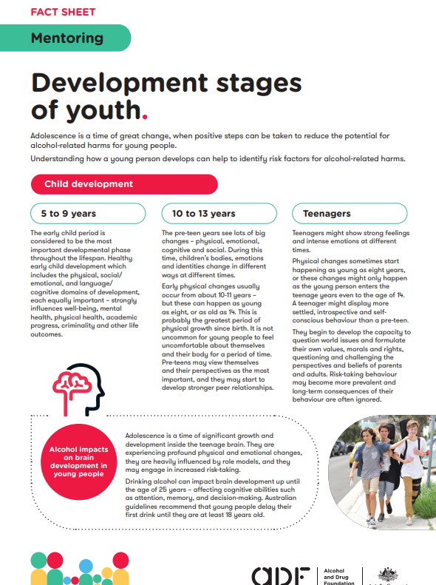
Developmental stages of young people
Notes:
Young people
Developmental stages of young people - available as a downloadable resource for you to provide to your mentors.

Slide 13
Insights into young people
What young people value
Issues of national importance
Where young people go for help
Activities young people are involved in
Issues of personal concern
Notes:
Young people
LDATs can generate discussion to develop a deeper understanding of young people by asking participants:
What do young people value?
Where do young people go for help?
What issues are young people personally concerned about?
What issues do young people believe are of national importance?
What activities are young people involved in?
A recent survey of young Australians aged 15–19 years identified both their values and issues of concern.
What young people value:
friendships
family relationships
school or study satisfaction.
Where young people go for help:
friends
parents or guardians
relative/family friend.
Issues of personal concern:
coping with stress
mental health
body image.
Issues of national importance:
equity and discrimination
COVID-19
mental health.
Activities young people are involved in:
sports (as a participant)
sports (as a spectator)
arts/cultural/music activities.

Slide 14

Who can be a mentor or a mentee?
Mentors are mature people aged over 18 years who want to assist young people to develop their potential.
Mentees are young people who want to gain from the encouragement, experience and expertise of an older person.
Notes:
Roles and responsibilities
Outline the roles of mentors and mentees. Provide the Mentor Role Description.
LDATs can generate discussion to explore the role of mentors by asking participants:
What are the key roles and responsibilities of mentors?
Additional points to share:
All mentors and mentees are expected to be:
committed to make the relationship constructive and respectful
sensitive to the needs of each other
flexible with time management
focussed on goals that build the skills of the mentee and draw on the expertise of the mentor
confidential in all aspects of the relationship
honest about the impact of the program.
Any relevant program eligibility criteria as determined by the LDAT.

Slide 15
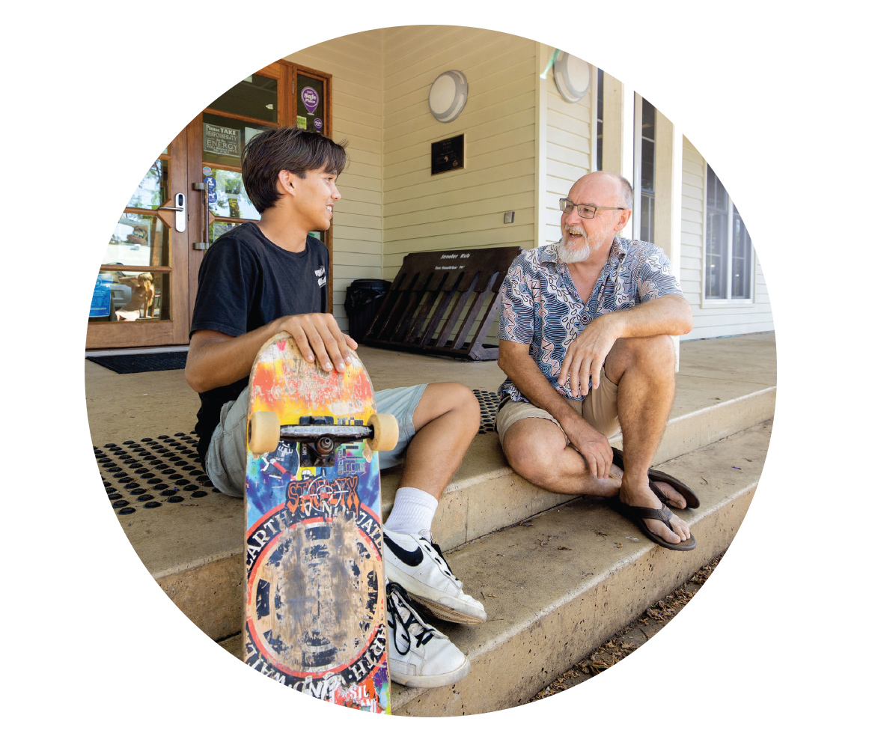
Code of Conduct - mentors
What are the key roles and responsibilities of mentors?
What are some of the things
that mentors must do/must not do?
Notes:
Roles and responsibilities
Discuss the Code of Conduct for mentors initially, and explore the expectations and boundaries of the mentoring relationship.
LDATs can generate discussion to explore expectations and boundaries by asking participants:
What are the key roles and responsibilities of mentors?
What are some of the things that mentors must do/must not do?

Slide 16
Policies and procedures
15 – Privacy and Confidentiality
16 – Crises and after-hours support
17 – OHS Including Risk Assessment
20 – Code of Conduct
25 – Sexual Harassment
31 – After Hours Support
32 – Critical Incidents
33 – Responding to Issues and Behaviours
36 – Substance or Drug Use Policy
43 – Ethical Guidelines
44 – Romantic Relationships
Notes:
Roles and responsibilities
LDATs should provide mentors with a printed copy of the relevant Policies and Procedures (see list on slide).
Ask mentors to read each policy and procedure, and generate discussion by asking:
What are the key points in each of the policies and procedures?
Is there anything surprising? Unclear? Missing?
Are the policies and procedures consistent with your expectations, and your understanding of the boundaries of the mentoring relationship?
Mentors may work in pairs, small groups, or a large group. LDATs may wish to note the key discussion points on a whiteboard or butcher’s paper.

Slide 17
Communication strategies
Tips for building trust and overcoming difficulties:
Stage 1 - Beginning of the match
Stage 2 - Challenging and testing
Stage 3 -‘Real’ mentoring
Stage 4 - Ending
Notes:
Communication and relationships
LDATs to facilitate a discussion about the importance of effective communication during the mentor/mentee relationship cycle. Provide handout: Communication strategies (available as a downloadable resource in module or in the Orientation section of the module) and ask participants:
What is occurring at each stage of a typical mentoring relationship? (Stages 1 through 4)
What practical communication strategies or tips may help to build trust and overcome difficulties? How may the strategies used differ, depending on the stage of the mentoring relationship?
Mentors may work in pairs, small groups, or a large group. LDATs may wish to note the key discussion points on a whiteboard or butcher’s paper.

Slide 18

Situations mentors may face
Notes:
Communication and relationships
Click on the play button on the embedded video (this will play from Youtube so you will need an internet connection).
After viewing the video, use the “Real Life Situations Mentors Face” scenario cards to generate discussion and build skills around communication and relationships. LDATs may wish to ask:
What other scenarios may you face, and how would you respond? Does your response align with the mentoring program policies and procedures?
Mentors may work through the scenario cards in pairs, small groups, or a large group. LDATs may wish to note the key discussion points on a whiteboard or butcher’s paper.
Following the scenario card activity, provide your participants with the Real life situations fact sheet.

Slide 19
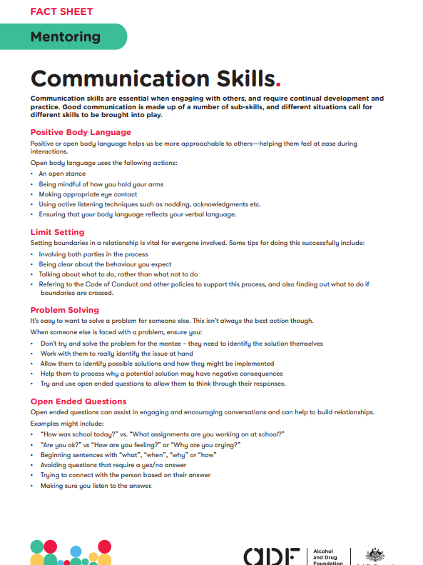
Communication and limit setting
Notes:
Communication and relationships
Communication and limit setting skills fact sheet - available as a downloadable resource for you to provide to your participants.
LDATs to review fact sheet with participants, and use “Communication and Limit Setting” scenario cards to generate discussion and build skills around communication and limit setting.
Mentors may work through the scenario cards in pairs, small groups, or a large group. LDATs may wish to note the key discussion points on a whiteboard or butcher’s paper.
LDATs may wish to refer to handout: The “do’s and don’ts” of building effective mentoring relationships, and ask:
What do effective mentors do?
What do less effective mentors do?

Slide 20
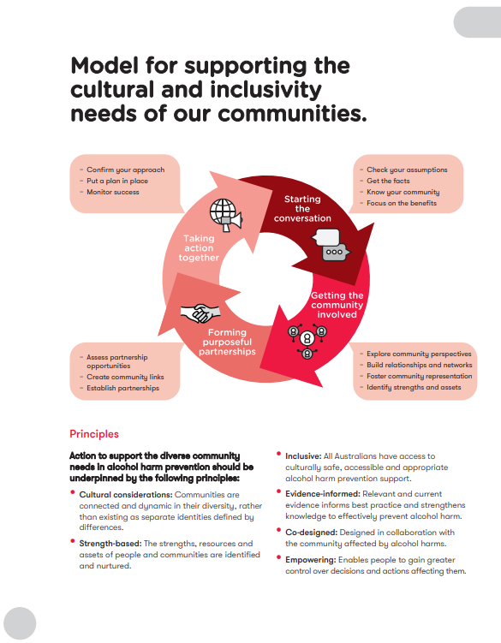
Working with different groups and cultures
Notes:
Working with different groups and cultures
LDATs to review cultural awareness fact sheet with participants and generate discussion around culturally appropriate practices. - available as a downloadable resource for you to provide to your participants.
LDATs may wish to share additional resources:
Fact sheet: Understanding people with disabilities
Engaging multicultural communities guide https://cdn.community.adf.org.au/media/documents/ADF_ConnectingDiversityGuide.pdf
LGBTI resource https://cdn.community.adf.org.au/media/documents/LDAT_LGBTI-Resource-final.pdf

Slide 21
Notes:
Thank participants, take questions, and close the training.
LDATs administer the post-training evaluation quiz (note – evaluation consultants to advise suitable timeframe etc)

